Slide 1
Important ACC Websites
College Prep
Mr. Gordon and Ms. Taylor from BHS
jgordon@bisdtx.org

Slide 2
Upcoming
Events
hi

Slide 3
Important ACC Websites
As an ACC student, there are a few websites that you need to be familiar with and will utilize on a regular basis over the next few years.
These are:
ACC Blackboard
ACC Self-Service
ACCmail
We will cover all of these in this Powerpoint
hi

Slide 4
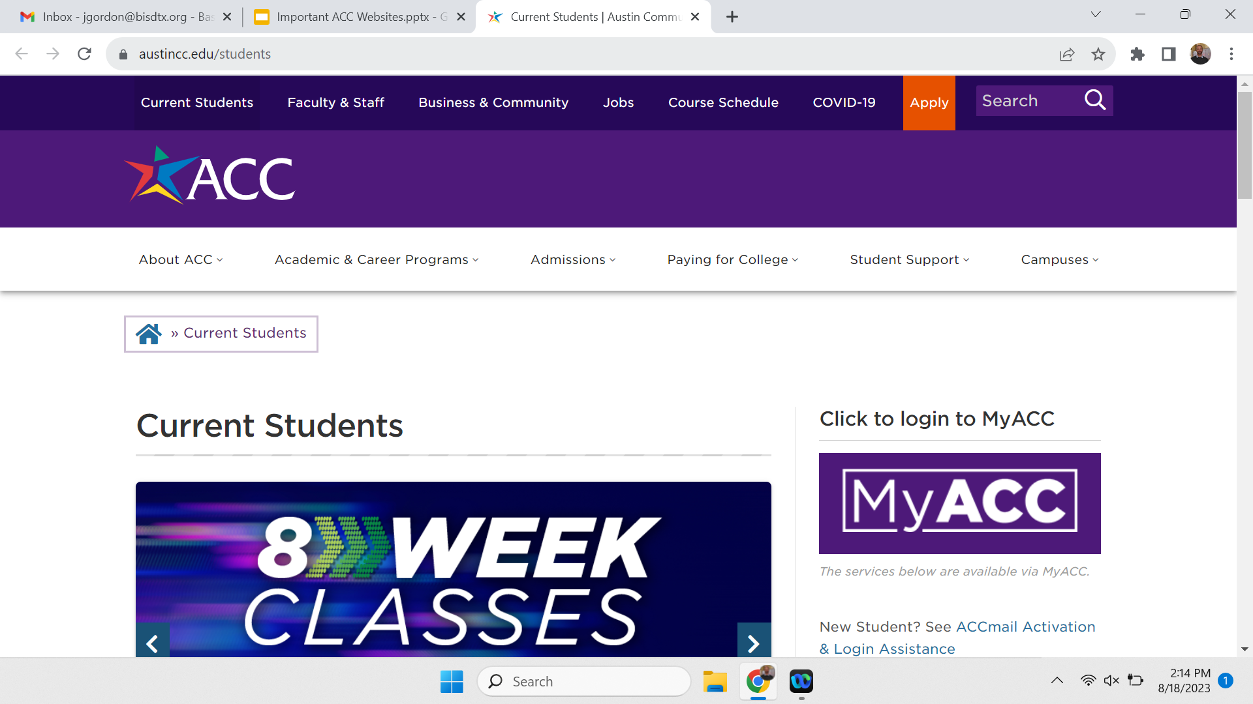
Important ACC Websites
All of these websites can be accessed here:
https://www.austincc.edu/students
hi

Slide 5
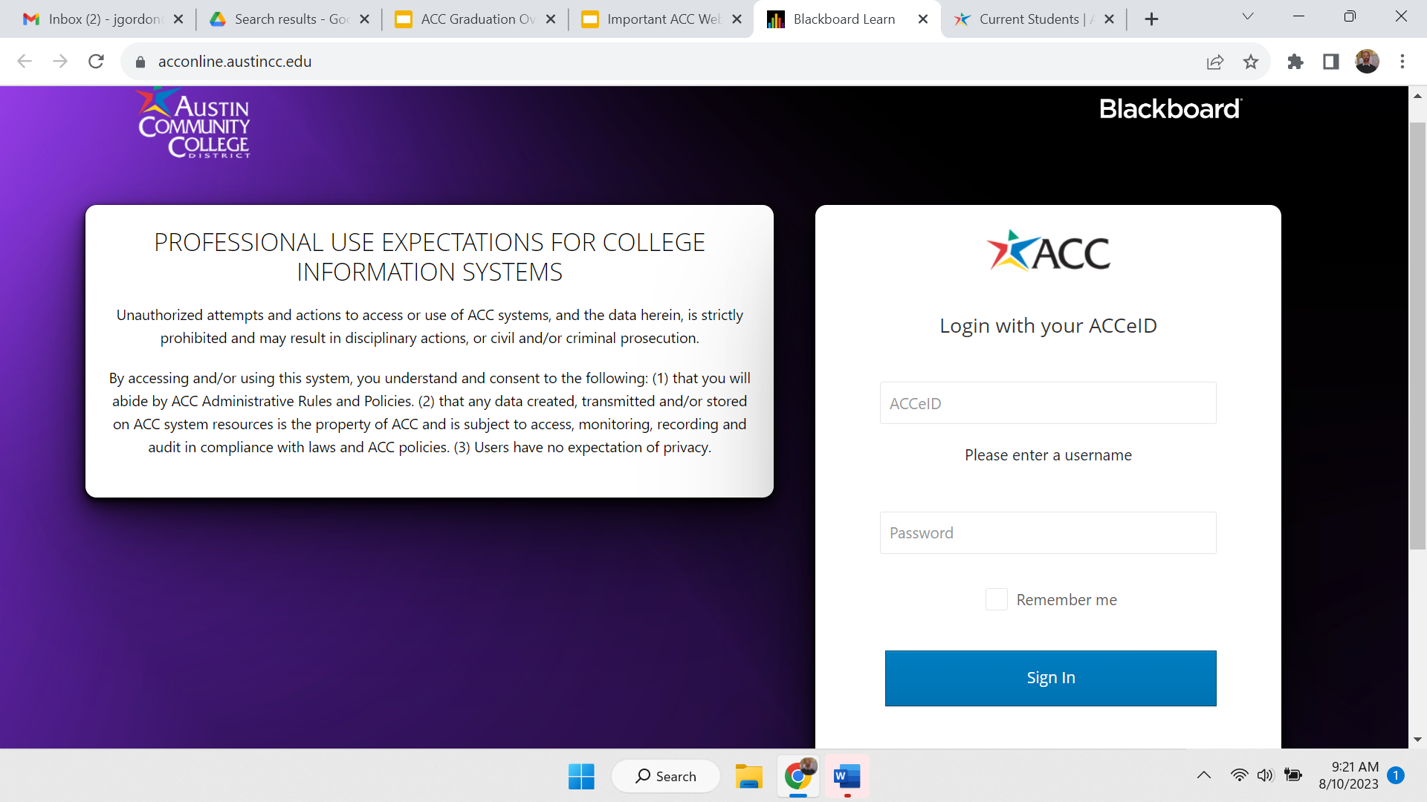
ACC Blackboard
https://acconline.austincc.edu/
hi

Slide 6
ACC Blackboard
ACC Blackboard is where:
Professors post current grades
Professors post class announcements and upcoming assignments
Where you can turn in assignments
hi

Slide 7
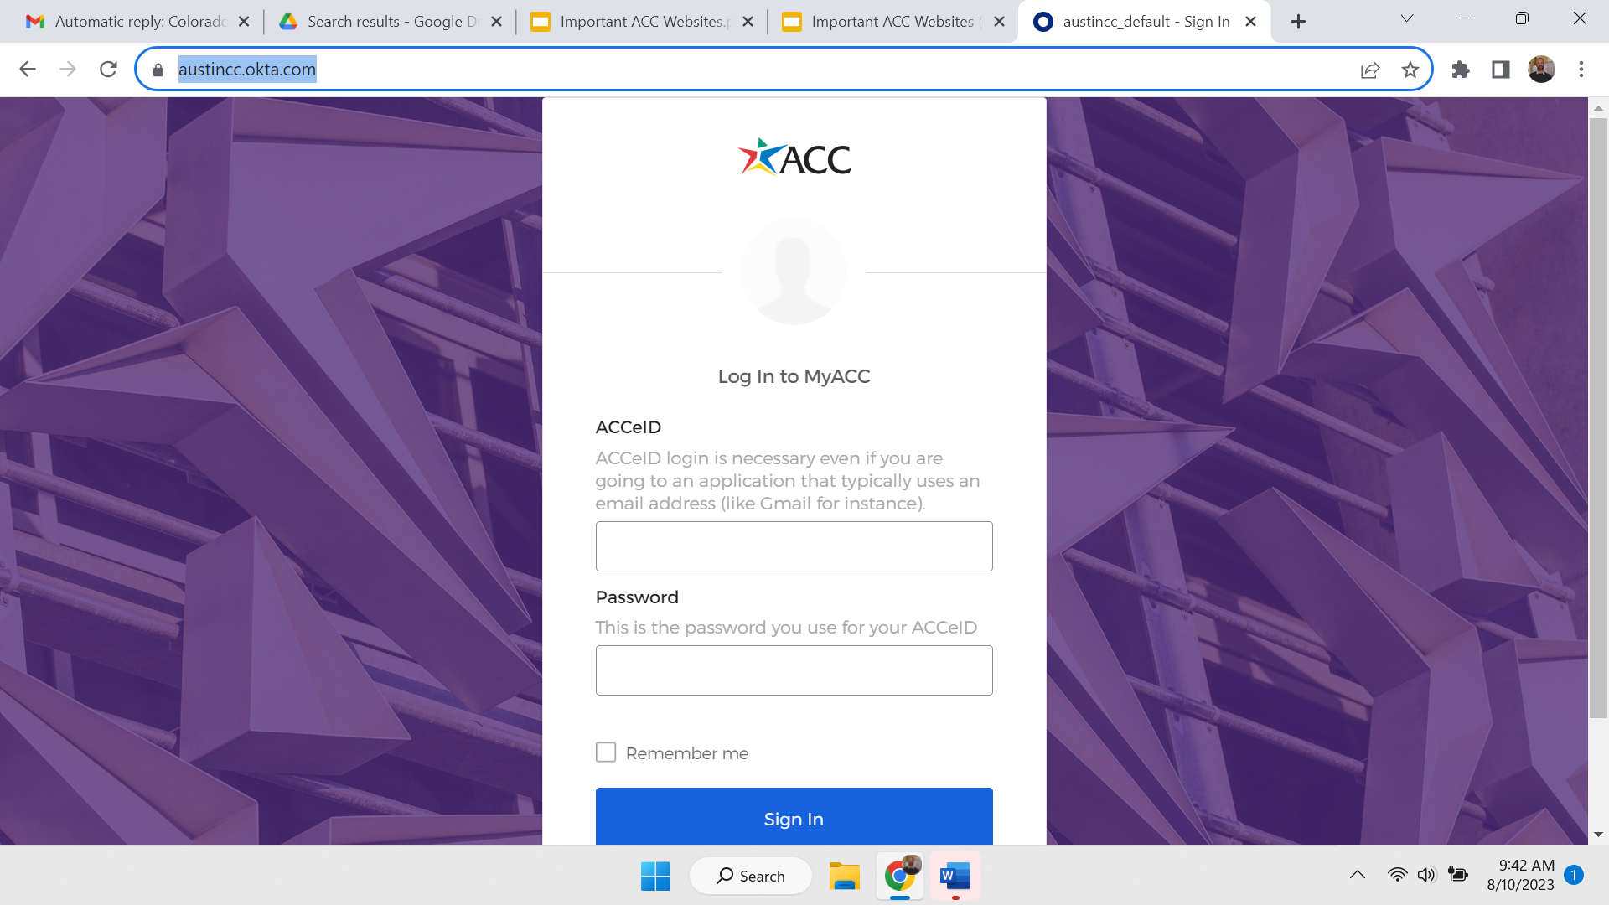
ACC Self-Service
https://austincc.okta.com/
hi

Slide 8
ACC Self-Service
ACC Self-Service is where you can:
Chart your progress on obtaining your Associate degree
See your most recent ACC GPA
Check your current schedule
Register and withdraw from classes
Many of these can be found in Graduation Overview. Steps and explanations on the following slides.
hi

Slide 9
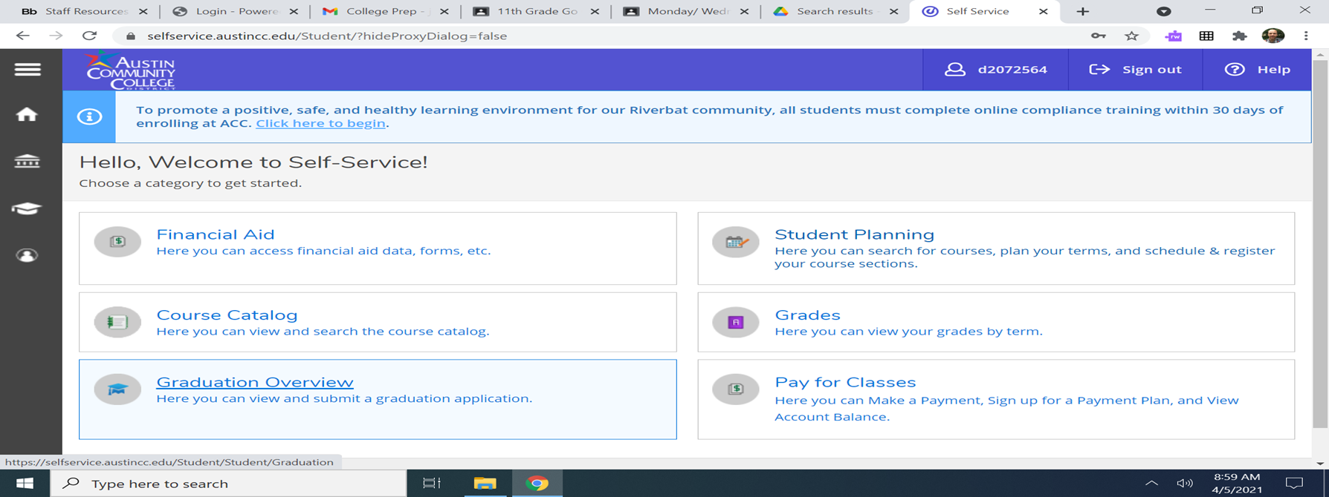
Graduation Overview
How to access and read “Graduation Overview”
hi

Slide 10
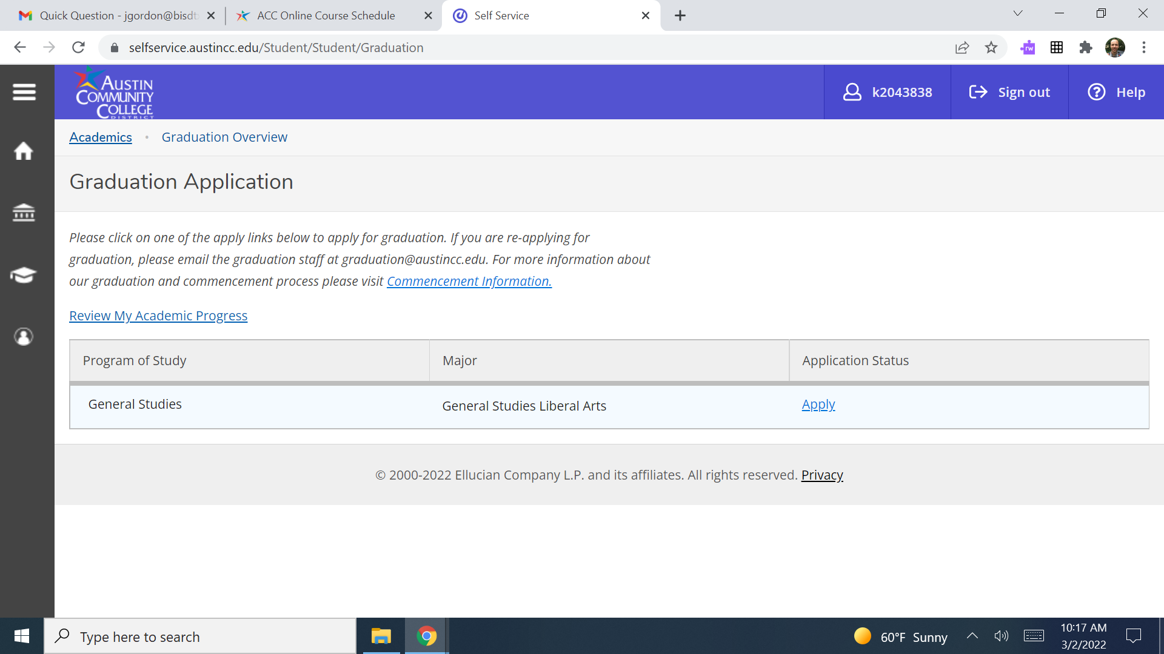
Graduation Overview
Click on “Review My Academic Progress”
hi

Slide 11
Graduation Overview
On Review My Academic Progress
GPA- not shown
Red Arrow- degree and major
Ex. Associate of Arts General Studies Liberal Arts
Purple Arrow- Credits completed (dark green)
ex. 26 (this is a Junior)
Blue Arrow- current credits being taken (light green)
ex. 9 (3 classes)
Orange Arrow- credits needed for Associate degree. You must have 60 to get your Associate degree, 15 left
hi

Slide 12
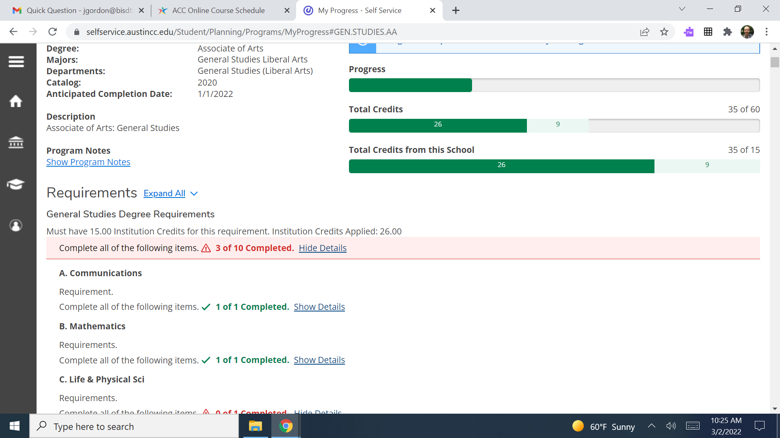
hi

Slide 13
Graduation Overview
Scroll down and you will see the requirements to graduate and how many you have
Red Arrow- completed ex. Speech
Not shown- planned
Blue Arrow- not started ex. Life and Physical Sciences
When all sections are complete, you have completed your degree.
hi

Slide 14
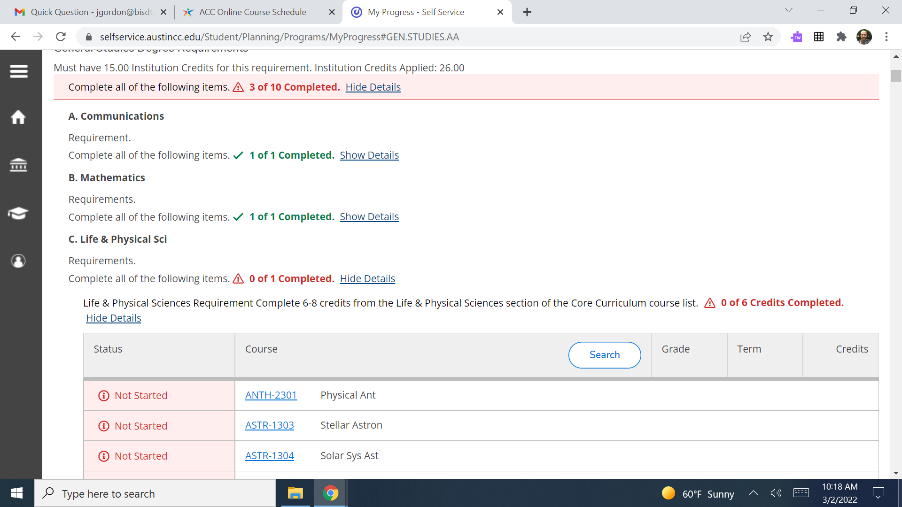
hi

Slide 15
ACC Email
https://students.austincc.edu/help/accmail/
ACC Email is where you will:
Receive emails from professors
Receive emails about ACC events and information
Receive emails from other ACC employees ie SAS (student accessibility services)
hi

Slide 16
ACC Email
Most students add this to their Gmail account.
When emailing a professor, you must always use your ACC account. Professors will not open an email from your BISD account.
When emailing your professor, remember always to be polite and professional. We will cover this at a later date.
hi

Slide 17
Today’s College Prep Assignment
In the comments section of today’s College Prep,
answer the following question:
What is your ACC degree?
hi

